Slide 1
#2 – Intro to coding with R
Nick Brown

Slide 2
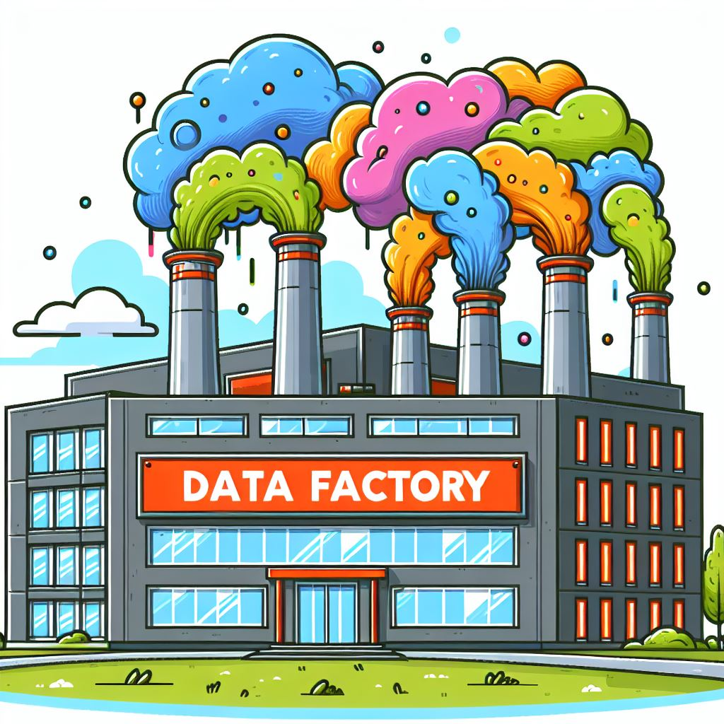
A metaphor for informatics…
A computer coding session is like building a factory for your data…

Slide 3
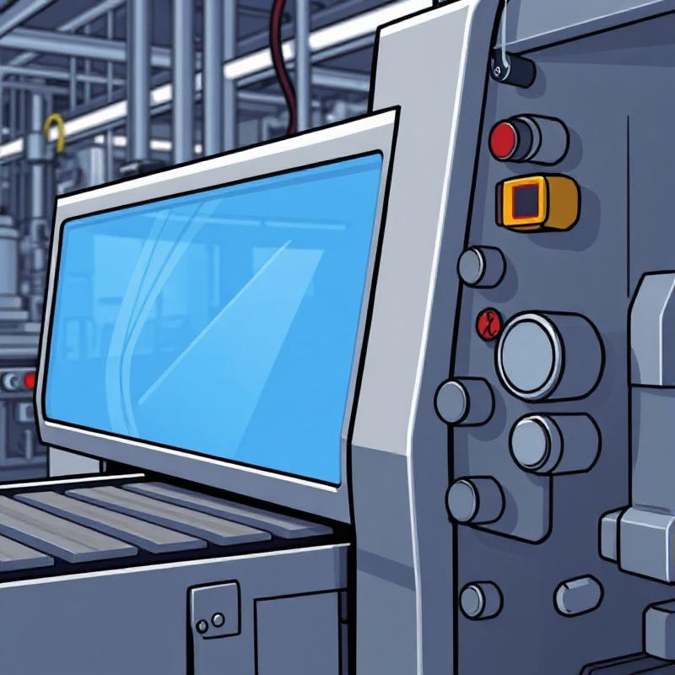
Functions and arguments
Functions are the machines that we will fill the factory with
Arguments are the settings we use for each function.

Slide 4
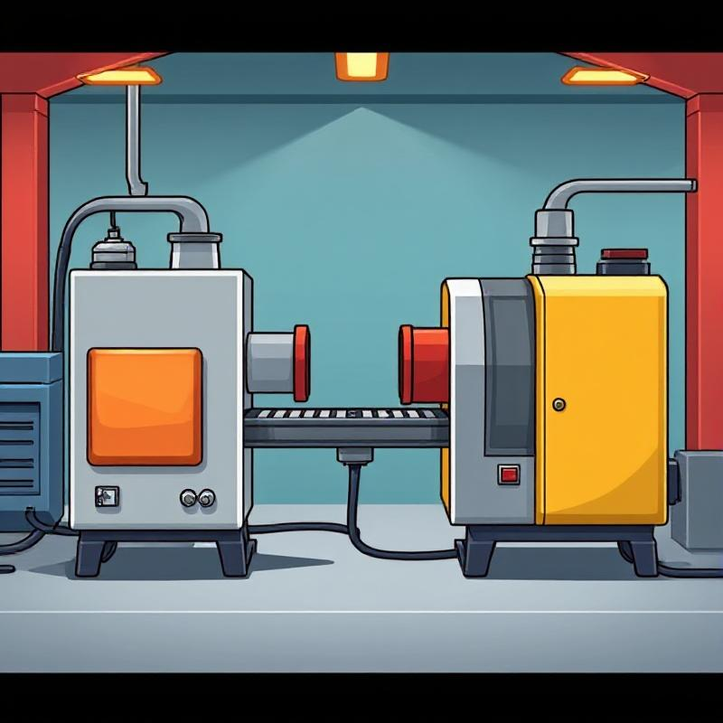
Setting up functions in a pipeline
Pipes will connect the output of one function to the input of another, like a conveyor belt in a factory.

Slide 5
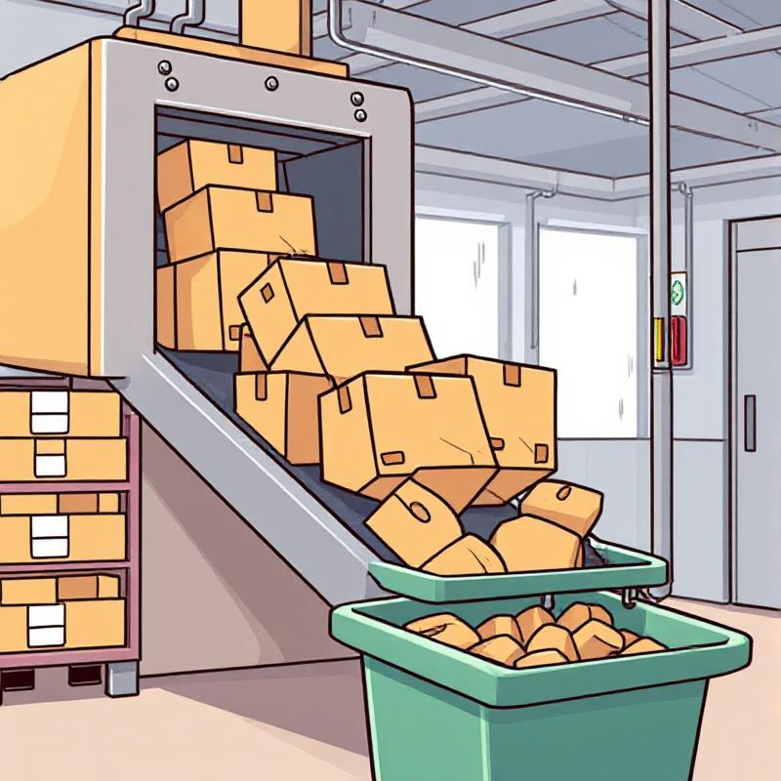
Collecting output in an object
Objects will collect the final output of our data pipeline, like a bin will collect completed packages in a factory.

Slide 6
Reviewing the metaphor
Computing session
Functions
Arguments
Pipes
Object
=
=
=
=
=
Data factory
Factory machines
Settings
Conveyor belt
Collection bin

